Slide 1
jQuery
Write less, do more…

Slide 2
jQuery
Write less, do more
jQuery is a JavaScript library
It makes writing JavaScript easier
It smooth out some browser incompatabilites

Slide 3
Preliminaries
<script src='http://ajax.googleapis.com/ajax/libs/jquery/1.6.1/jquery.min.js'> </script>
You can download the library from google.
This means it may be your user’s cache.
$(document).ready
The ready function takes a function as a parameter.
The function is executed when the page has loaded.
This is a useful time to set up the page

Slide 4
Example
<!doctype html>
<html>
<head><title>Timetables</title>
<script src='http://ajax.googleapis.com/ajax/libs/jquery/1.6.1/jquery.min.js'> </script>
<script src='hello.js'></script>
</head>
<body>
<div id='container'>
…
// hello.js
$(document).ready(function(){
alert("Hello world");
});

Slide 5
The $ function to select
The $ function returns a list of matching elements
It uses css style matches
It uses XPath style matches
<table id='key'>
<caption>Key</caption>
<tr><th>HCI</th><td>Human Computer Interaction</td></tr>
<tr><th>ISO</th><td>Information Systems in Organisations</td></tr>
<tr><th>SD</th><td>Software Development in Java</td></tr>
</table>
$(document).ready(function(){
$('#key th').css('color','red');
});

Slide 6
Function css
$('#key th').css('color','red');
The $ function returns a list of elements
The css function is applied to each of these elements
The css function can take an attribute and a value as shown
It can also take a “map” of attribute/value pairs:
$('#key th').
css({backgroundColor:'black',color:'white'});

Slide 7
The $ function to create
You can use $ to create nodes
You can use append or prepend to add
//The basic
$('body').append($('<div>Hide key</div>'));
//With styling
$('body').prepend($('<div/>',{text:'Hide key',
css:{color:'blue'}}));

Slide 8
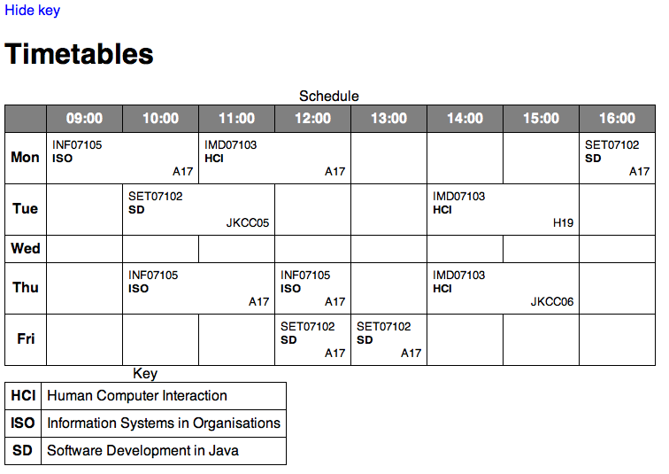
A link to “toggle” the second table

Slide 9
Functions required
html
This has two forms
html() returns the contents of the node as a string
html("one two three") changes the contents
is
This takes a css or Xpath expression and returns true or false
click
This property attaches a function that will be applied when the user clicks
fadeIn and fadeOut
fadeOut makes an element disappear – it can take “fast” or “slow” or milliseconds

Slide 10
More Complex
$('body').prepend($('<div/>',
{text:'Hide key',
css:{color:'blue’, cursor:'pointer'},
click:function(){
if ($('#key').is(':visible')){
$('#key').fadeOut('slow');
$(this).html('Show key');
}else{
$('#key').fadeIn('slow');
$(this).html('Hide key');
}
}
}));

Slide 11
mouseover and mouseout
You can change elements on mouseover.
You can use this to refer to the element you are over:
Notice that only non empty items are affected
$('table td:not(:empty)').mouseover(function(){
$(this).css('background','red');
});
$('table td').mouseout(function(){
$(this).css('background','inherit');
});

Slide 12
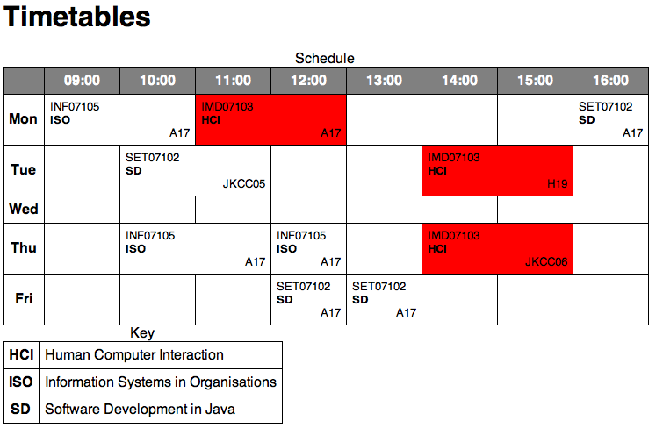
A more complicated example

Slide 13
Using filter, find and first
$('table td:not(:empty)').mouseover(function(){
var module = $(this).find('div').first().html();
var l = $('td:not(:empty)').filter(function(){
return $(this).find('div').first().html()==module;
});
l.css('background','red');
});
$('table td').mouseout(function(){
$('table td').css('background','inherit');
});

Slide 14
filter
Applied to a list of elements
Takes a function that returns true or false
The function can use the index or the object this
It returns only those elements that pass the test

Slide 15
find
find is applied to a list of elements
You can include css or XPath strings
It searches the descendants of the element and returns those that match
The function parents does the same thing for ancestors
first
The function first returns only the first element from the list
The function last does something similar
You can include a css or XPath string as a condition

Slide 16
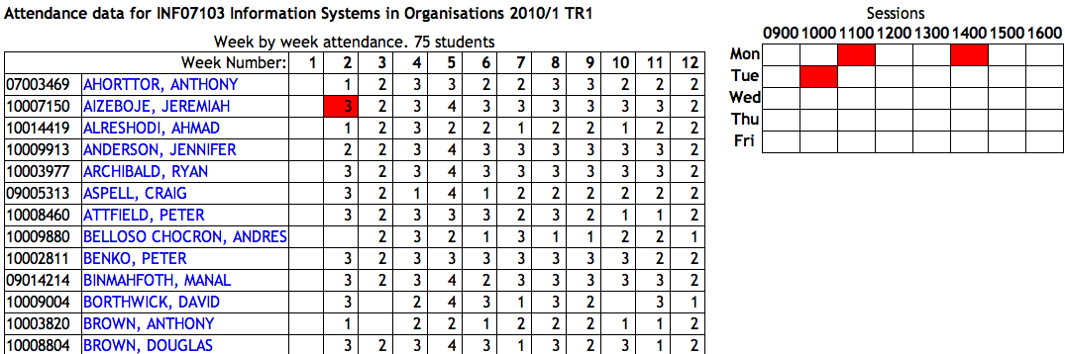
Task 1
Use ~andrew/lincrea/jQuery/attend.htm to make the interaction shown

Slide 17
Task 1 Help
The big grid has id mw
The small grid has id weekGrid
The cells in the small grid have id such as Mon0900 or Wed1200
The cells in the big grid have title such as “Mon0900 Tue1000”
You can use the jQuery attr function to get the title:
var slot = $(this).attr('title');
You can use the JavaScript function split to get the components:
var slots = slot.split(' ');
A for loop in JavaScript can go like this:
for (var i=0;i<slots.length;i++)

